Slide 1
Team 1
Chinmay Dixit
Akanksha Dhyani
Anshuman
Dhruv
Fiza Anwar
Global Admin Bank
Management System

Slide 2
Problem Statement
Interpretation
Log-in page to perform admin-related activities
Options to Add/Delete/Display Bank Customer Details
Options to Add/Delete/Display Bank Customer Details
Assumptions
Bank already has some Branches
Bank already has Customers in their different Branches

Slide 3
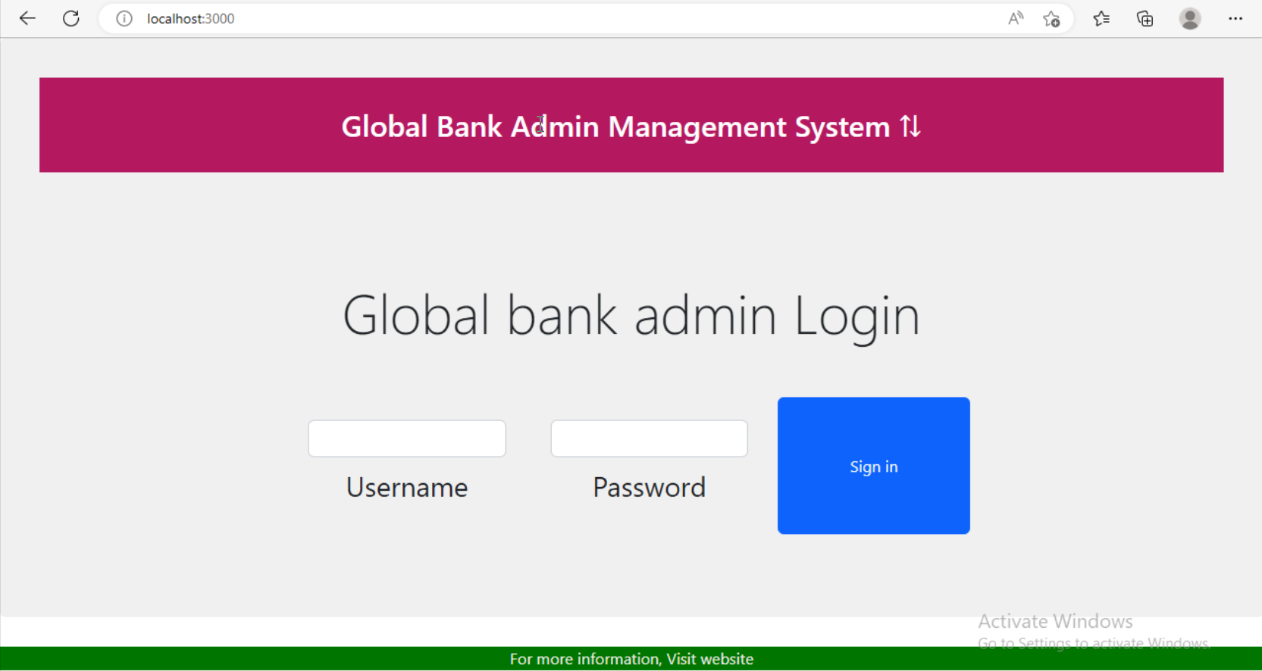
User Story 01 - Admin Login Page

Slide 4
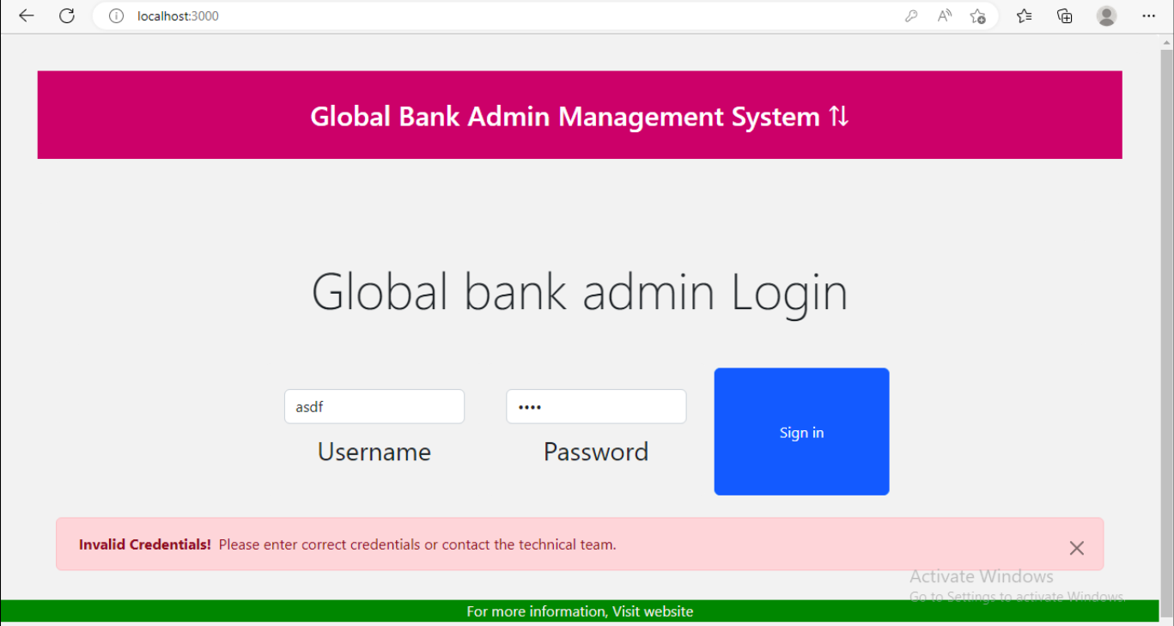
User Story 01 - Admin Login Page

Slide 5
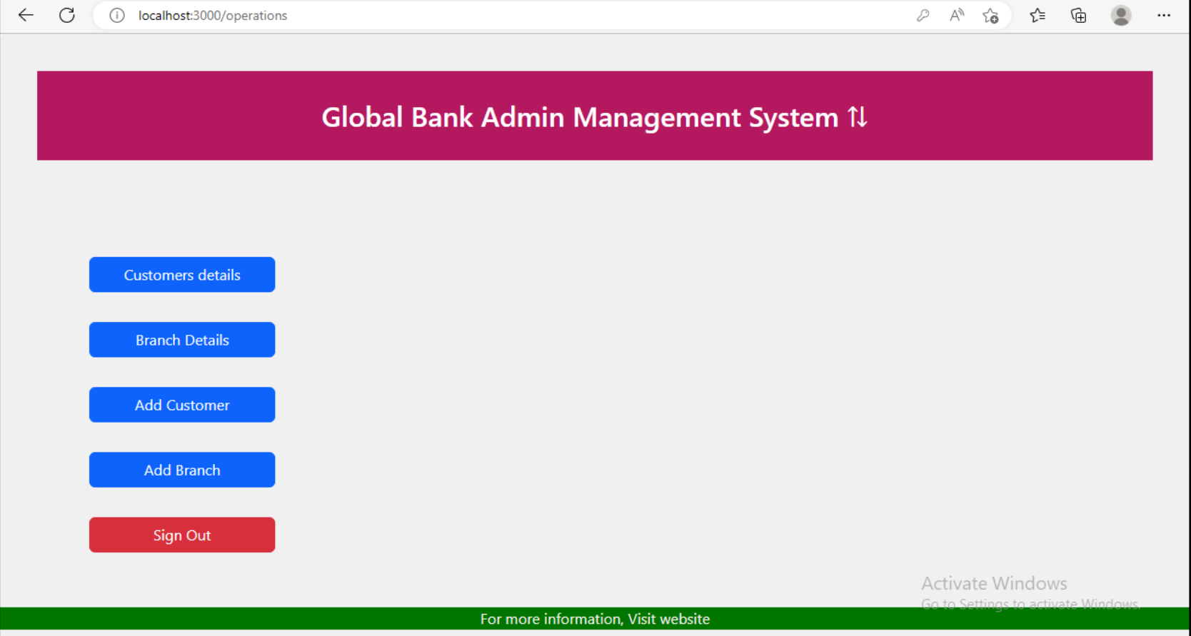
User Story 02 - Admin operations menu

Slide 6
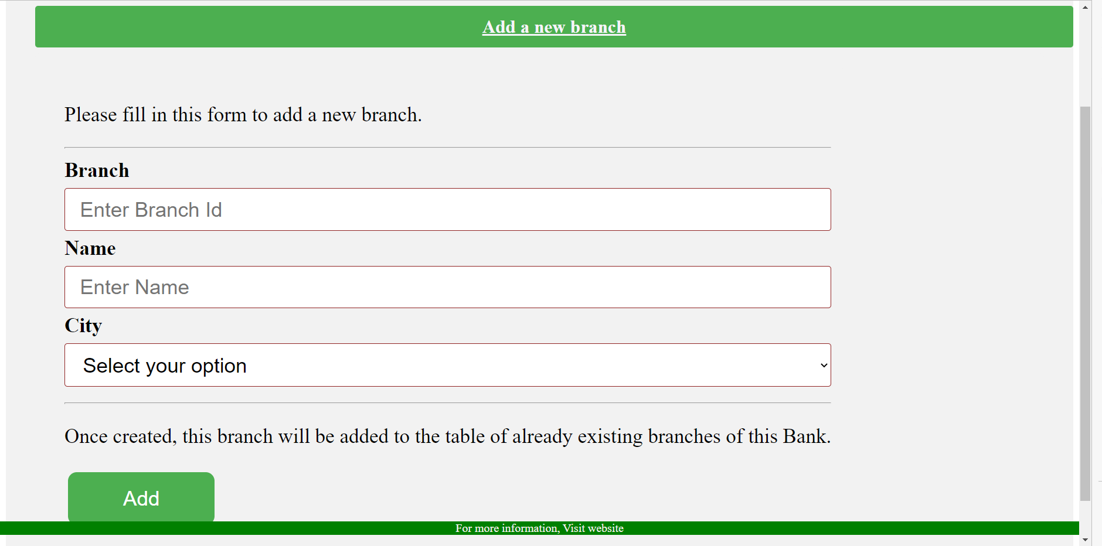
User Story 03 - Adding New Branch

Slide 7
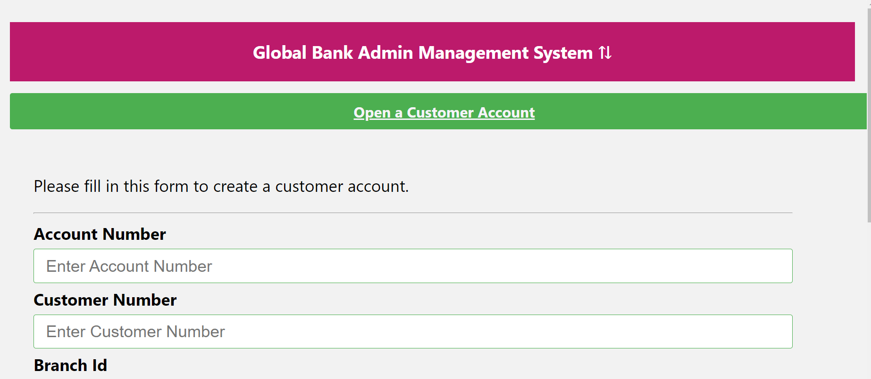
User Story 04 - Opening Customer Account

Slide 8
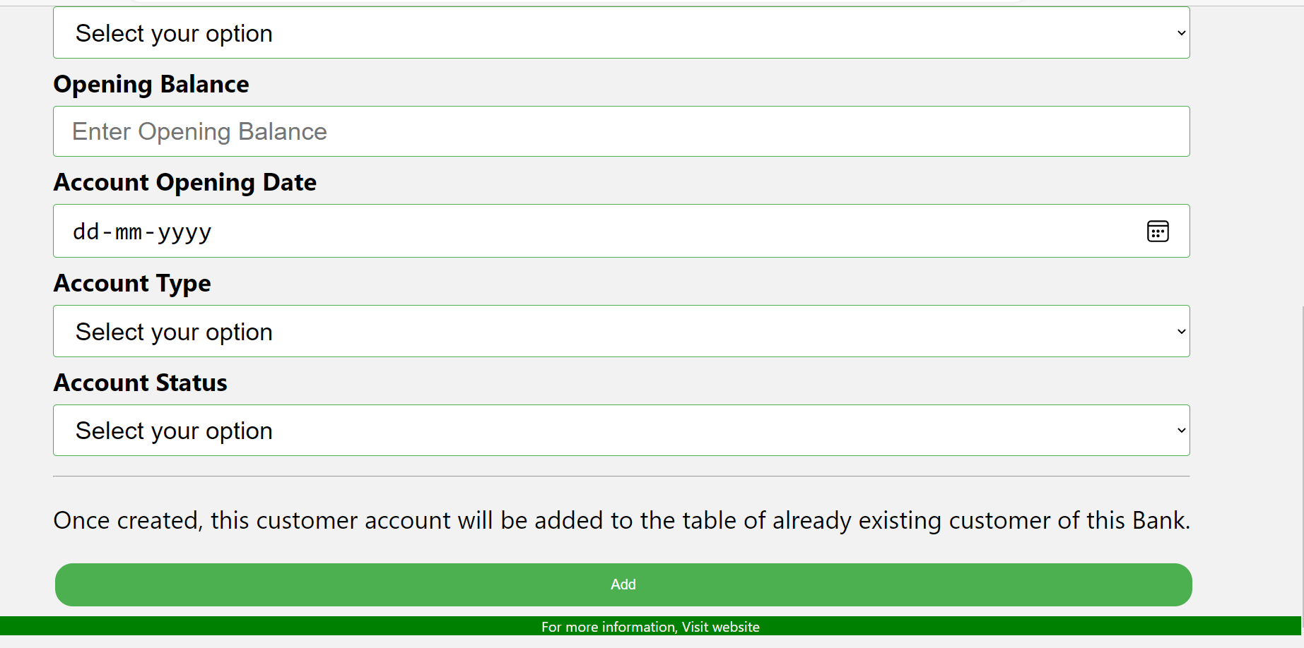

Slide 9
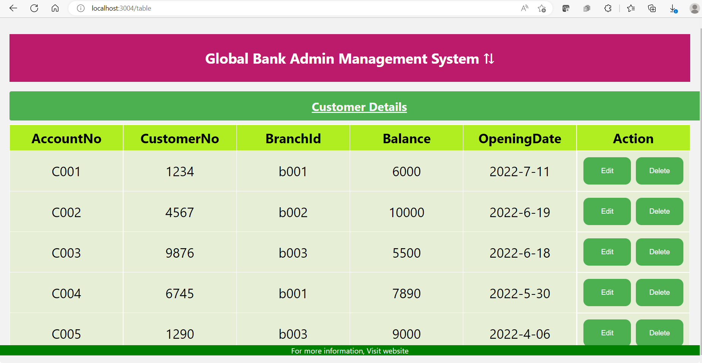
User Story 05 - Display customer details

Slide 10
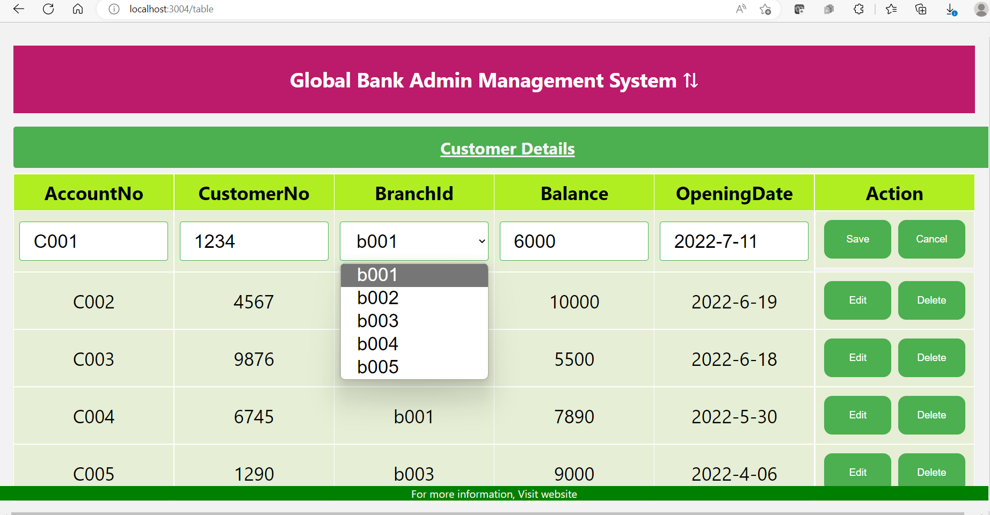
User Story 05 - Editing customer details

Slide 11
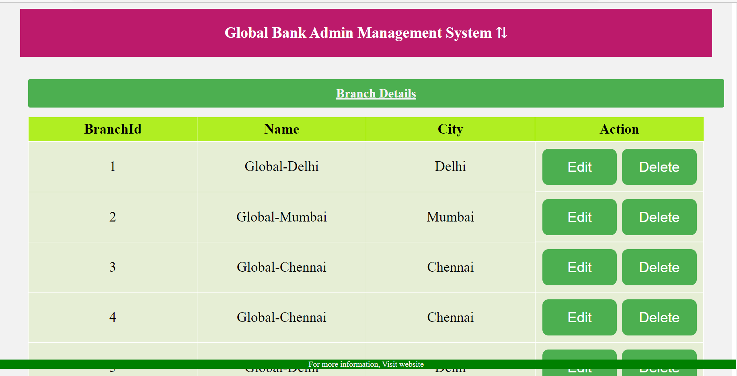
User Story 06- Display Branch Details

Slide 12
Schema
branch_id | branch_city | branch_name
varchar | varchar | varchar
customer_number | customer_city | customer_contact_no | customer_date_of_birth | firstname | lastname | middlename | occupation
varchar | varchar | varchar | date | varchar | varchar | varchar | varchar
branch_master
customer_master
account_number | account_opening _date | account_status | account_type | branch_id | customer_number | opening_balance
varchar | date | varchar | varchar | varchar | varchar | bigint
account_master

Slide 13
Thank you

